Slide 1
Animals and Climate Change One future for all living things

Slide 2
Ninth grader at BLS Zoo Volunteer Zoo Youth Council Member

Slide 3
Why I’m here today
Climate change is happening now
Changes are affecting all animals, including humans
There are things we all can do to make a difference
It’s up to our generation
We need to get connected and work together as a community

Slide 4
Animal Pop Quiz!

Slide 5
Question One:
How many Amur Leopards are there in the wild?

Slide 6
Question One:
Answer: 57
How many Amur Leopards are there in the wild?

Slide 7
Question Two:
How many northern white rhinos are left?

Slide 8
Question Two:
How many white rhinos are left?
Answer: 4
There were 500 just thirty years ago.

Slide 9
Question 3:
How many elephants are killed by poachers every year?

Slide 10
Question 3:
How many elephants are killed by poachers every year?
Answer: 30,000. That’s two every hour.
Central Africa has lost 64% of its elephants in the past ten years.

Slide 11
Question 4:
How many animal species go extinct every year?

Slide 12
Question 4:
How many animal species go extinct every year?
Answer: More than 1,000
99% of endangered species are at-risk because of human activities.

Slide 13
Question 5:
How many acres of rainforest are destroyed each year?

Slide 14
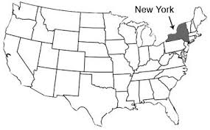
Question 5:
How many acres of rainforest are destroyed each year?
Answer: 78 million
An area the size of New York State is lost every year.

Slide 15
Question 6:
How many people does it take to make a difference?

Slide 16
Question 6:
Answer: One
How many people does it take to make a difference?

Slide 17
How did the situation get this way for animals?

Slide 18
Climate Change
350 parts per million of carbon in the atmosphere is considered safe.

Slide 19
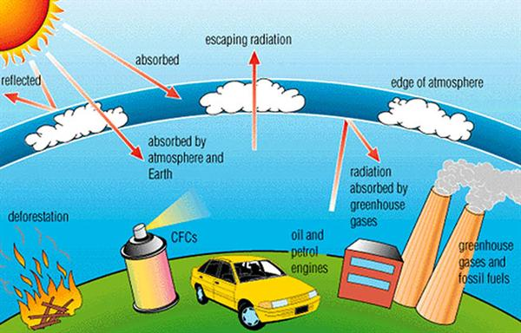
Climate Change
350 parts per million of carbon in the atmosphere is considered safe.
We just passed 400 parts per million.

Slide 20
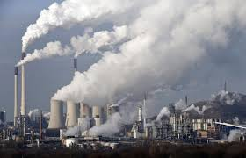
Climate Change
The carbon we burn every day is hurting animals around the world.

Slide 21
[how cc affects animals]
Animals can’t adapt fast enough for changes – evolution takes generations
-research a couple of other facts

Slide 22
And, there are other factors that affect anials…

Slide 23
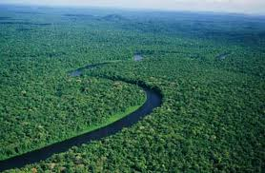
HABITAT DESTRUCTION is the main threat to 85% of endangered species. Habitat is destroyed for the profit of large companies.
Half of the world’s original forests are gone.
70% of land lost to animals is for agriculture.

Slide 24
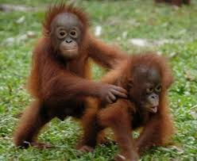
EXAMPLE: PALM OIL
Equivalent of 300 football fields are cleared EVERY HOUR to make room for more palm oil trees.
Palm oil is in 40-50% of all household products: baked goods, shampoo, detergent, even toothpaste.
Indonesia and Malaysia: the orangutan could be extinct in 5-10 years and the Sumatran tiger in only 3 years because of habitat lost to palm oil plantations.

Slide 25
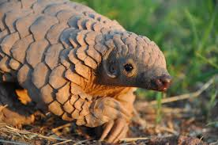
POACHING affects many species. Animals are killed for one body part that is worth a lot of money. Elephant tusks are sold for $1,000 per pound to make jewelry, figurines, and other objects. Poor people are exploited to hunt the animals.
Because of poaching:
-The black rhino population is down 98% in the past fifty years.
-The lion is extinct in seven African countries
-There are only 2,000 Grevy’s zebras left in the wild
-Up to 80,000 pangolins were killed last year for their scales

Slide 26
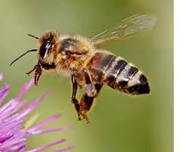
CHEMICALS from pesticides, insecticides and herbicides have a huge effect on animals.
-Pesticides found in 100% of rivers and streams in the U.S.
-72 million birds are killed by pesticides in the U.S. every year
-3,900 species of amphibians are in trouble because of chemical pollution
-165 species of amphibians have already gone extinct in the last 30 years
-Bee populations are dropping by 30% every year
We rely on bee pollination for at least 25% of our food.

Slide 27
If we know all of these things are hurting animals and causing extinctions, why don’t we stop them??
Greed, etc

Slide 28
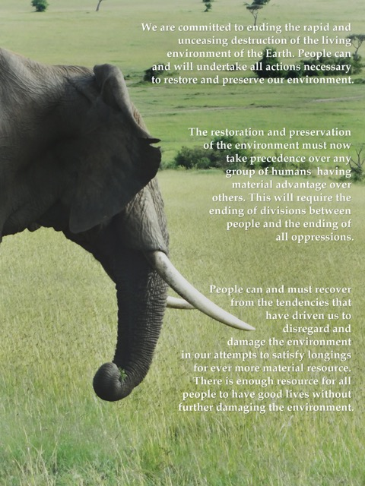
Every human being should have enough resources, and no one should have

Slide 29
CHANGE IS POSSIBLE!
For the climate and for animals.
[Diane S – hopeful stats about change

Slide 30
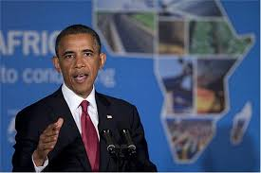
CHANGE IS POSSIBLE!
Just a few years ago, there were only 26 Amur Leopards.
President Obama is supporting laws to ban selling ivory and giving $10 million for anti-poaching efforts in Africa.

Slide 31
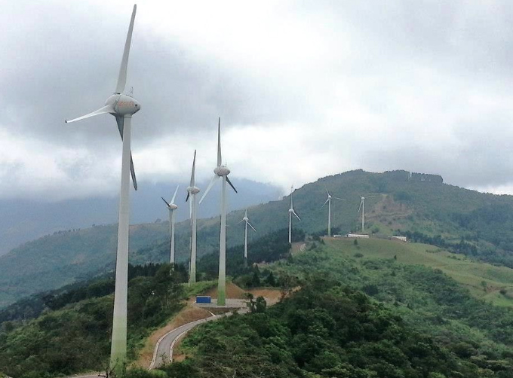
Costa Rica has found ways to get almost all of their electricity from renewable sources.
Young people are advocating for a healthy atmosphere and a sustainable climate by bringing lawsuits in all fifty states through Our Children’s Trust.

Slide 32
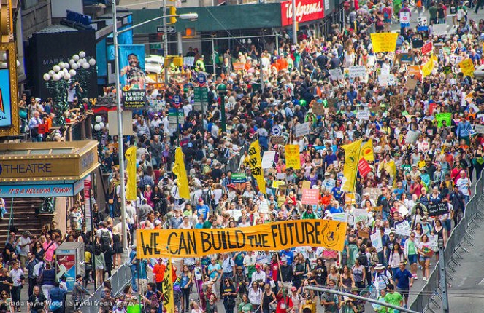
More than 500,000 people went to New York City for the People’s Climate March in September 2014, one of 2,600 events that weekend in 162 countries.

Slide 33
Zoos are helping, too!
Zoos play a critical role in helping animal species survive.
AZA accredited zoos have more than 450 programs through the Species Survival Plan to maintain healthy, genetically diverse captive populations.
Zoos educate 180 million visitors every year about climate change and its effect on animals.
Zoos do research and help conservationists protect animals in the wild.
Zoos raise money to fund conservation efforts around the world.
Interesting fact: More people go to AZA accredited zoos in the US than to all NFL, MLB, NHL and NBA games combined. Zoos educate a lot of people!

Slide 34
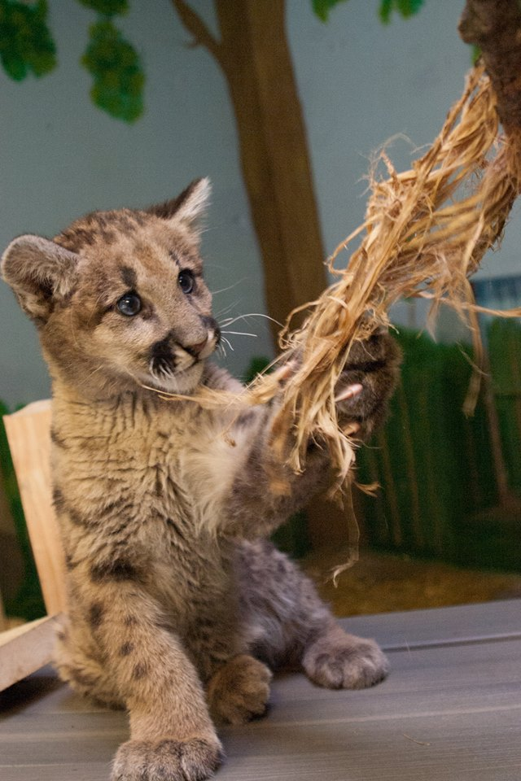
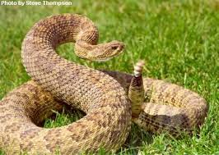
And lots of other cool stuff!
Franklin Park Zoo is:
Rescuing injured animals like Blue, an American Cougar now living at the Stone Zoo.
Saving the rattlesnake population in the Blue Hills.

Slide 35
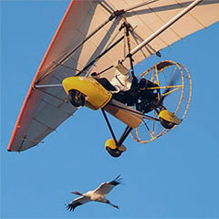
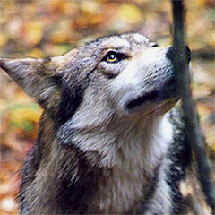
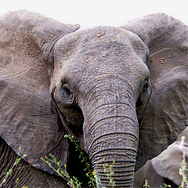
Helping whooping cranes migrate by following ultralight aircraft
Re-introducing Mexican Gray Wolves in the American Southwest.
Supporting 96 Elephants, an organization working to save wild elephants.

Slide 36
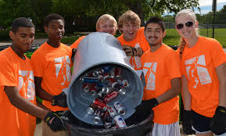
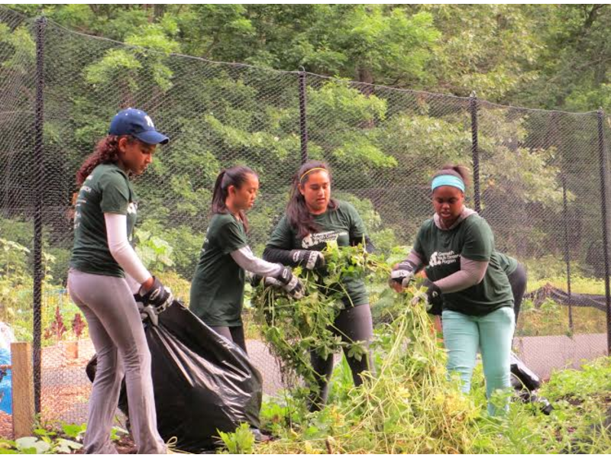
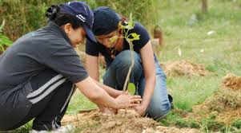
So…What can YOU do to make a difference for the climate and for animals?

Slide 37
Recycle
Compost
Turn off the lights and turn down the heat and air conditioning when you leave the house
Organize “Power Down Fridays” at your school
Send a letter to your legislators asking them to support the bill to ban ivory sales in Massachusetts
Send a letter to Home Depot and ask them to stop selling RoundUp because it kills bees
Plant a tree or a garden
Walk or ride your bike instead of driving

Slide 38
